Slide 1
Minor Presentation
Image Captioning using Neural Network
Project guide: - Submitted by:
Prof. Deepali Y. Kelkar Mr. Anuj Arya
Mr. VinitGurjar

Slide 2
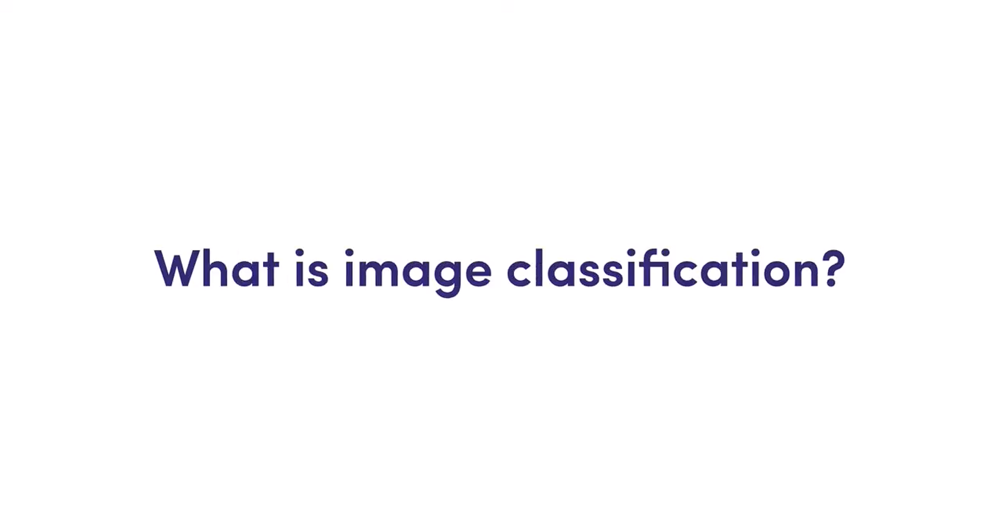

Slide 3
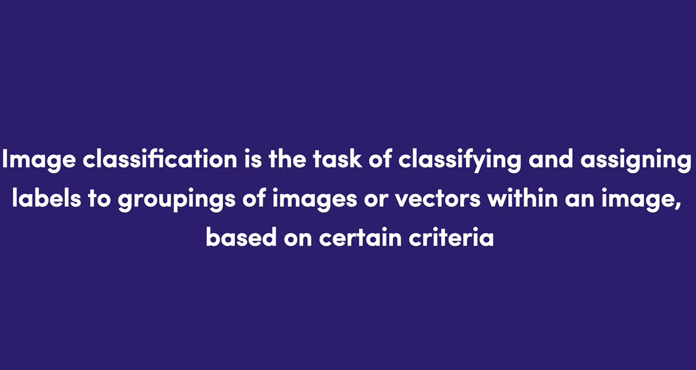

Slide 4
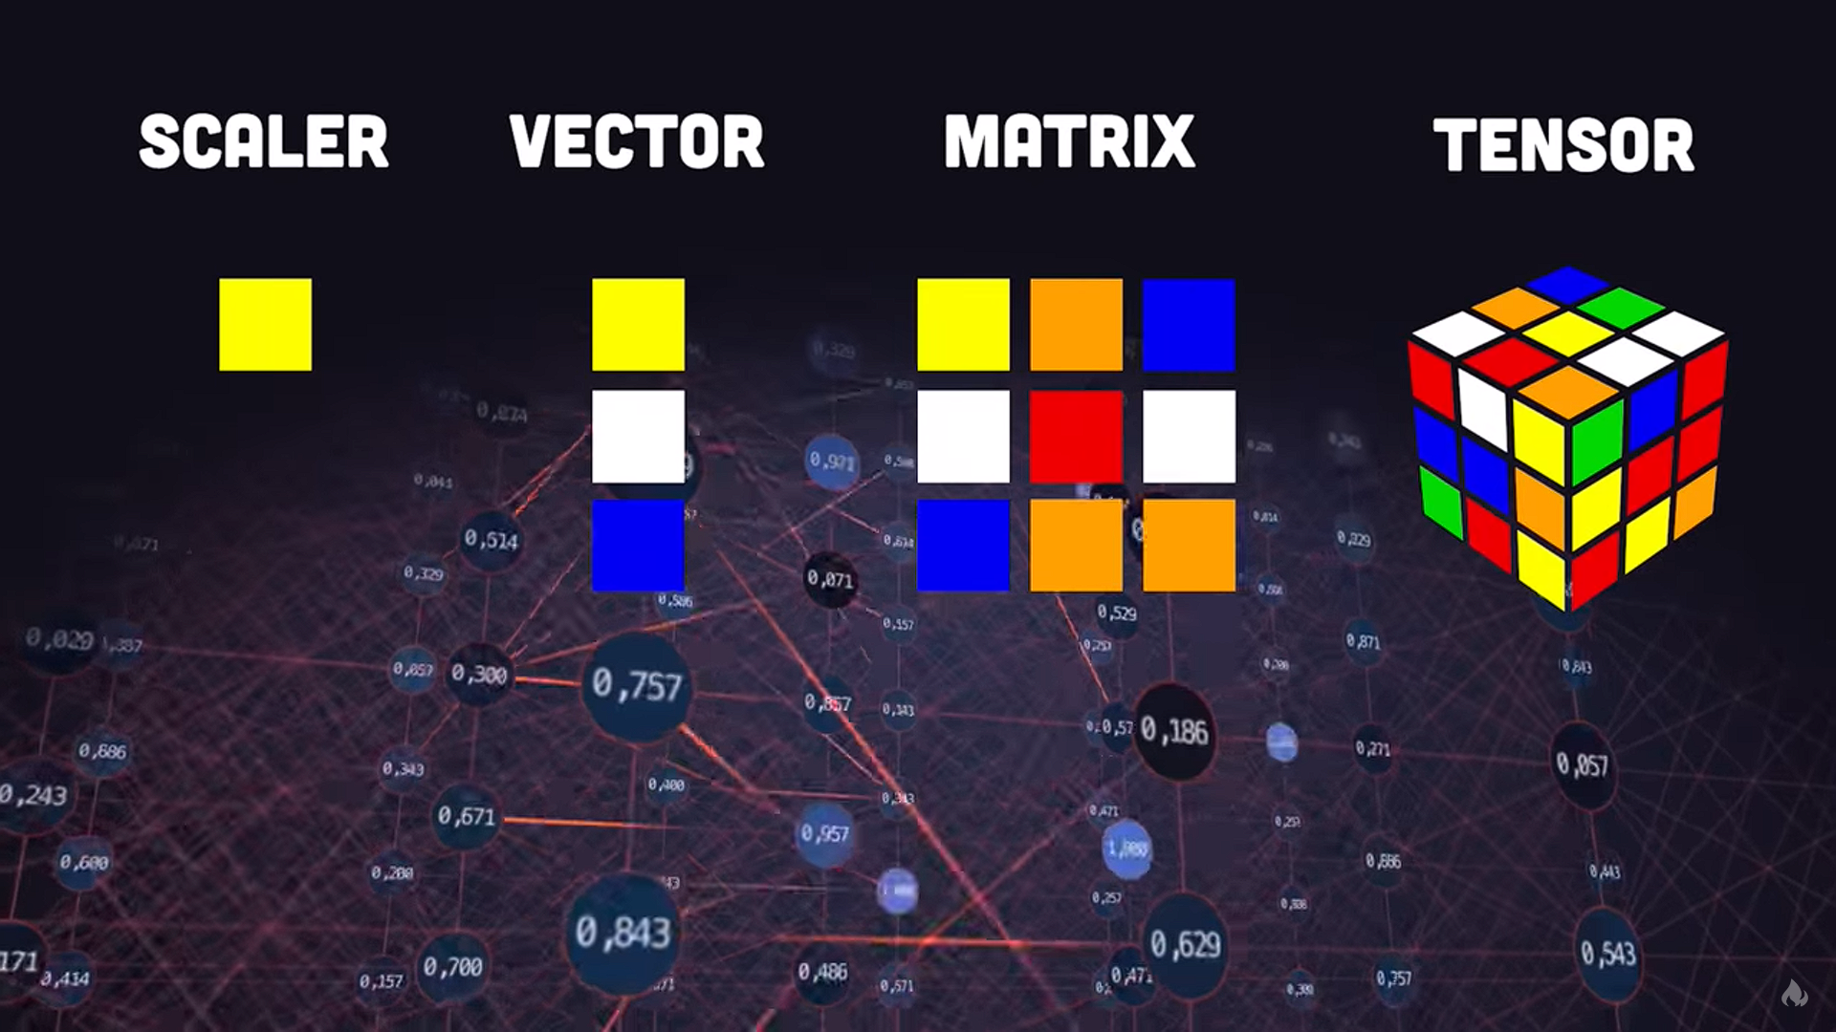

Slide 5
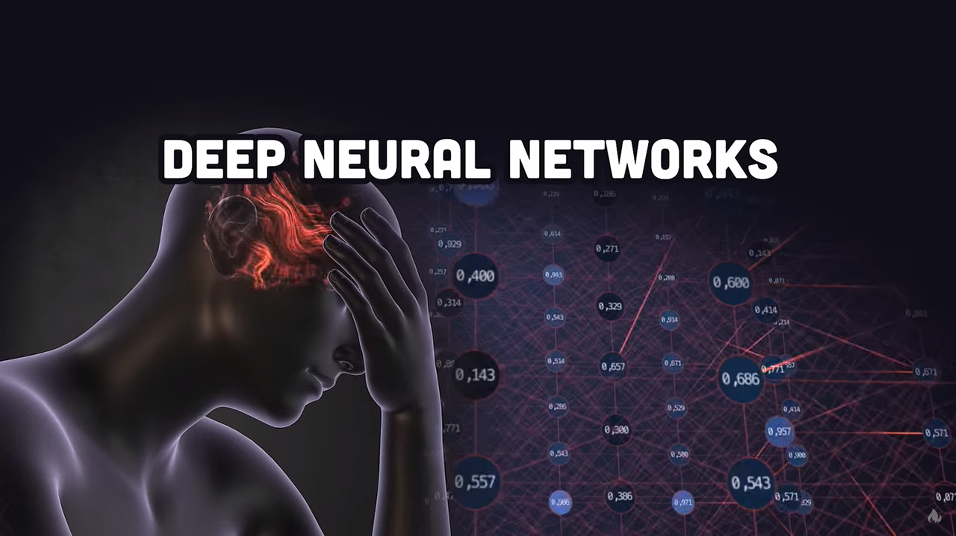

Slide 6
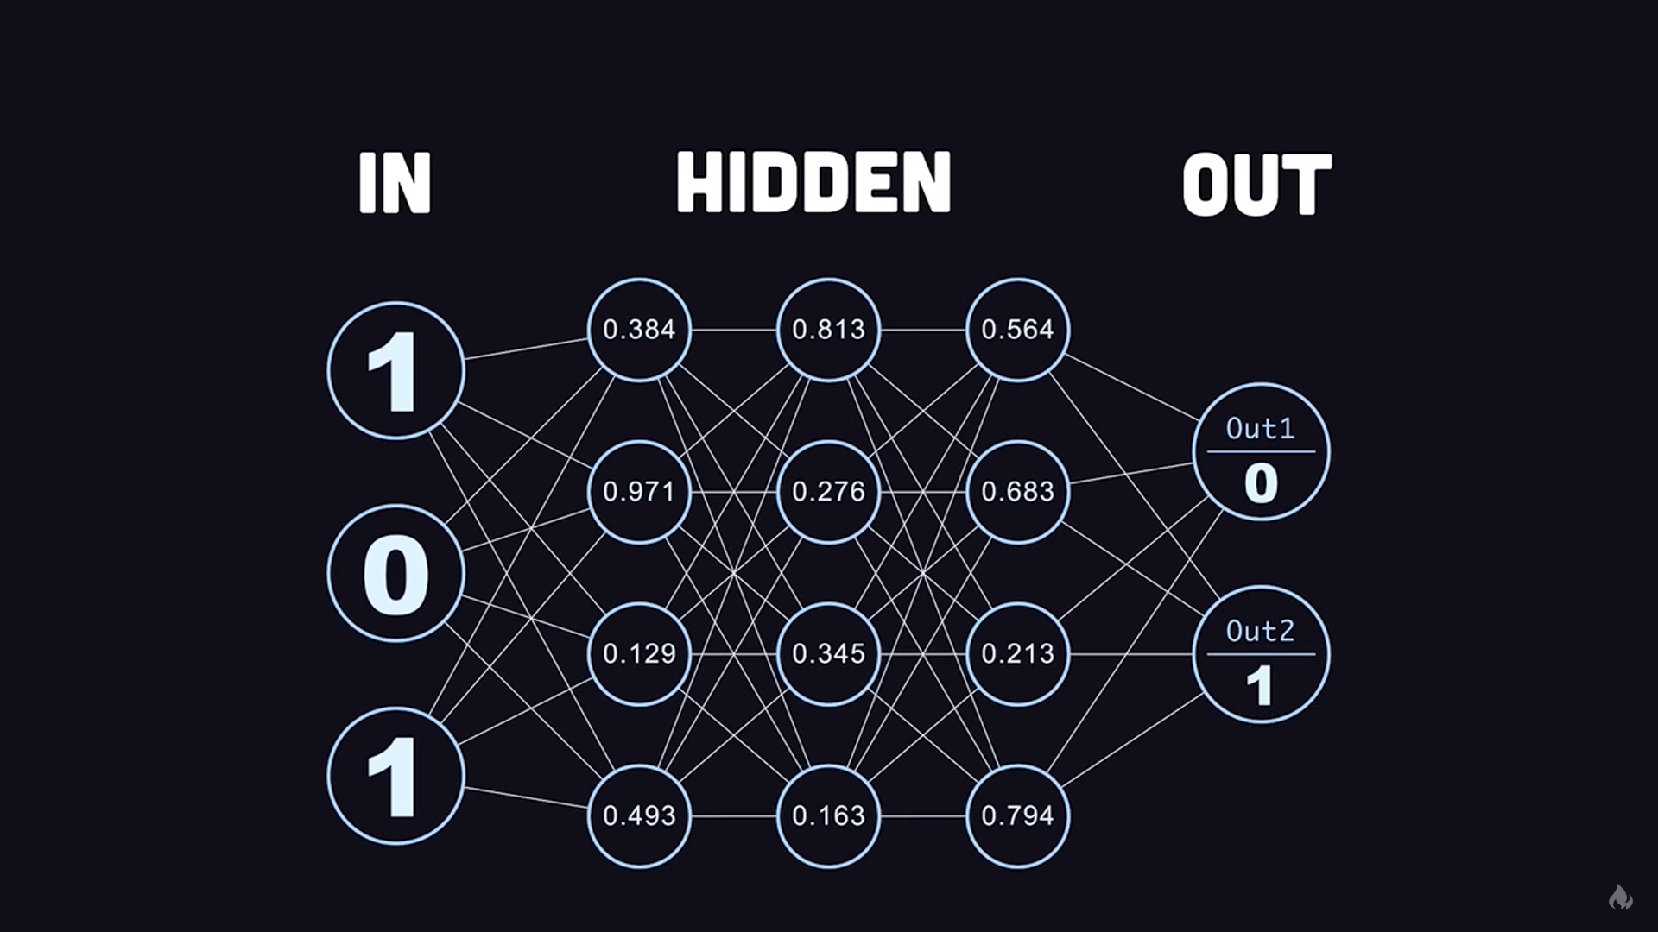

Slide 7
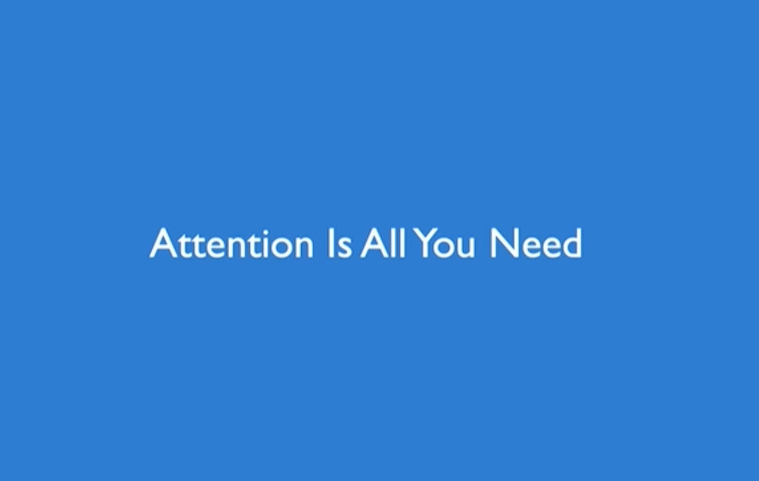

Slide 8
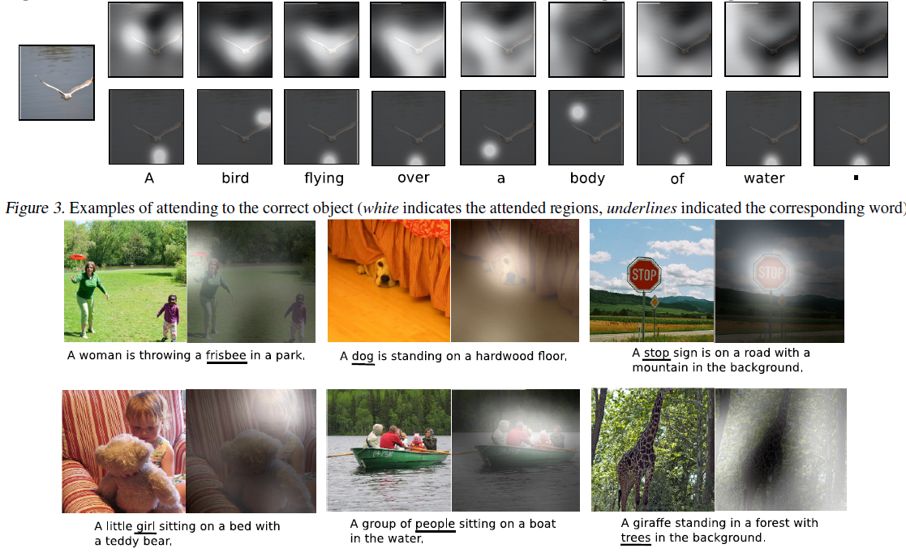

Slide 9
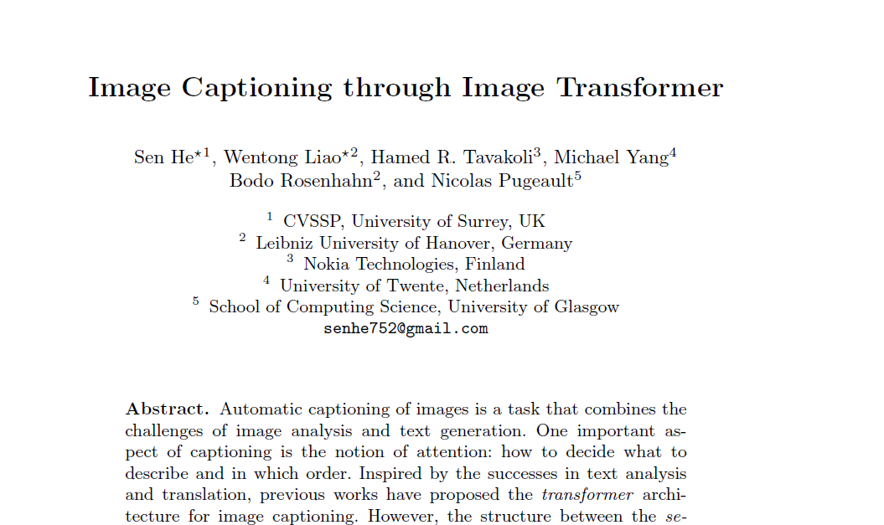

Slide 10
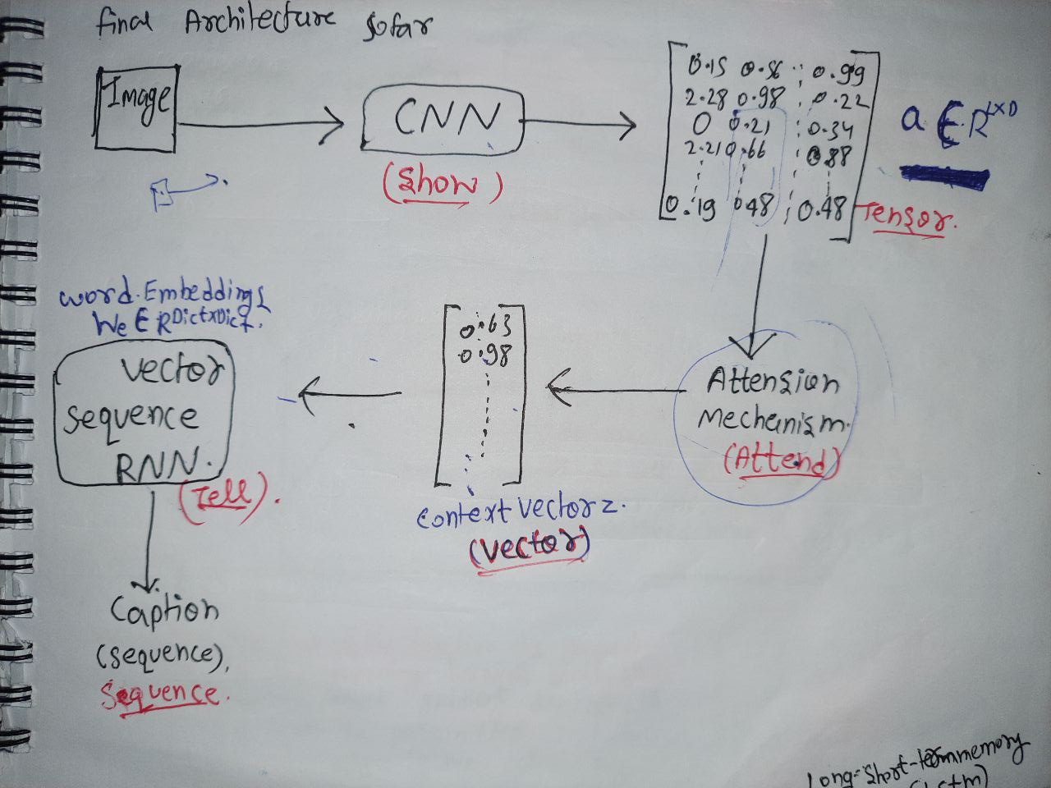
The Traditional model

Slide 11
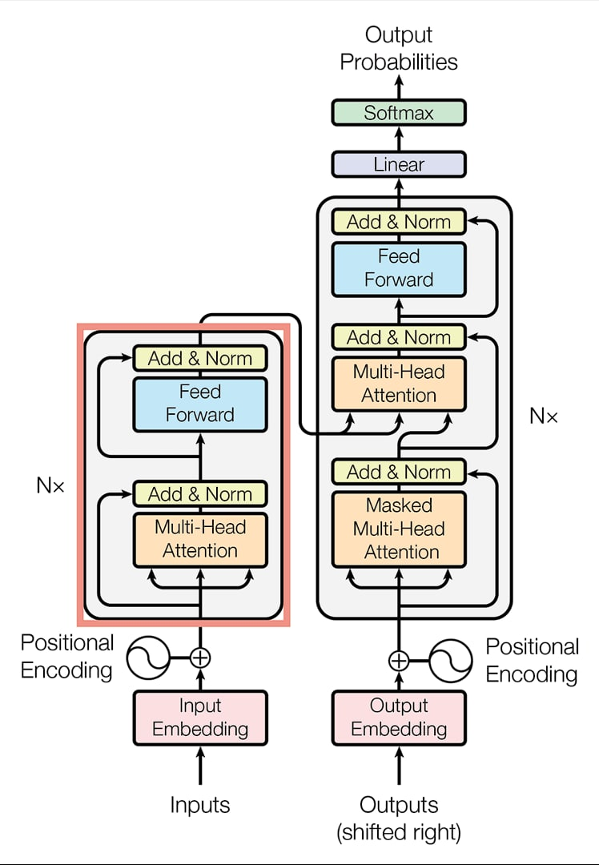
The Transformer Model

Slide 12
Model Components
Importing dataset(Cleaning dataset)
Splitting Training data and validation data
Text Pre-processing
Text Vectorization
Tokenization
Img_to_caption Vector
Image Preprocessing
Traninig Data set is ready
TD Passed to CNN > Creates Feature vector
Passed to Encoder > Context vector
Passed to decoder > Learn to generate Caption
Model is trained for testing

